Slide 1
STA3180 After The Bell Progress Report
By: Anthony, Finn, Luke, and Zachary

Slide 2
Research Question
“How does parental involvement in school and home activities impact student performance (grades)?”
“Is this impact different depending on school level (Elementary, Middle, or High School)?”
Note: Only the 2019 curated data is being considered.

Slide 3
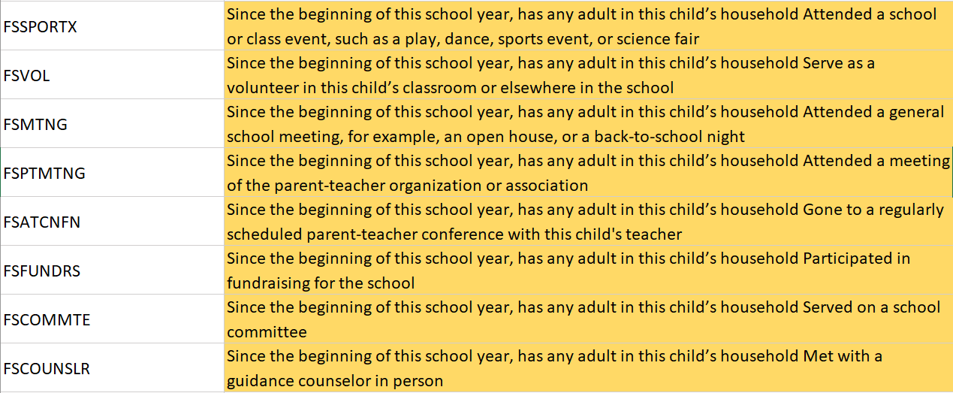
Predictors
We are using two sets of binary (yes/no) questions, each combined into a single numeric variable as our predictors.
The first set of questions describe “Adult at School” (AAS) involvement.
The number of Yes responses to these questions (0-8) = adultAtSchoolSum

Slide 4
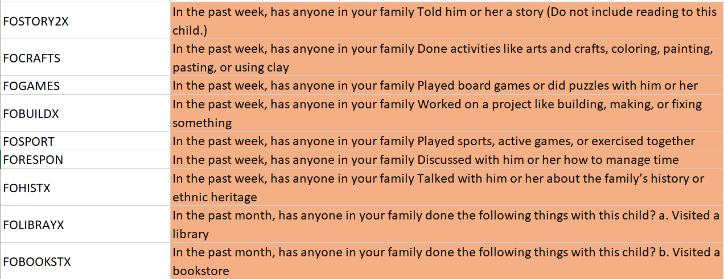
Predictors
Similarly, the second set of questions describe “Adult at Home” (AAH) involvement.
The number of Yes responses to these questions (0-9) = adultAtHomeSum

Slide 5
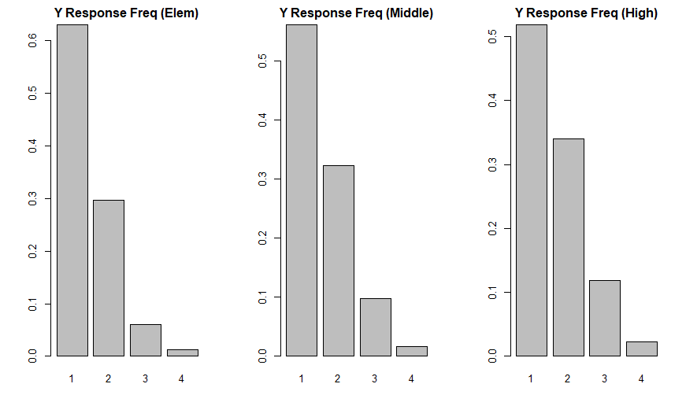
Response
We are trying to predict “SEGRADES”, a categorical variable with the following encodings for a given students’ grades:
1 = Mostly A’s
2 = Mostly B’s
3 = Mostly C’s
4 = Mostly D’s or lower
5 = School does not use this grading system

Slide 6
Data Cleaning
Removed any rows with -1 as an observation (invalid data)
Encoded each observation based on school level
1 = Elementary, 2 = Middle, 3 = High
Removed any rows where SEGRADES=5
This removed approx. 2000 observations from Elementary level
Changed predictor encodings from (1/2) to (0/1)
Calculated adultAtHomeSum and adultAtSchoolSum

Slide 7
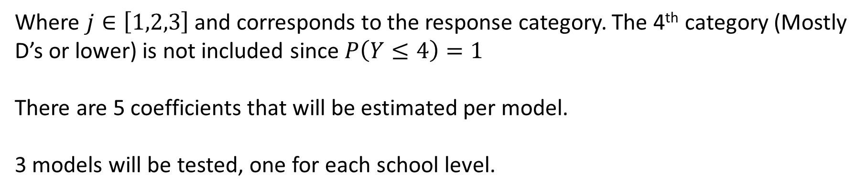
Model Setup
We decided to test a Cumulative Logit Model with Proportional Odds on our data due to the categorical response variable
$$log\left(\frac{P(Y≤j)}{1−P(Y≤j)}\right)=α_{j}+β_{1}\left(adultAtSchoolSum\right)+β_{2}(adultAtHomeSum)$$
Where $j∈\left[1,2,3\right]$and corresponds to the response category. The 4th category (Mostly D’s or lower) is not included since $P\left(Y≤4\right)=1$
There are 5 coefficients that will be estimated per model.
3 models will be tested, one for each school level.

Slide 8
Unexpected Results
The Elementary model output suggests that for any fixed j, the odds that a 1-unit increase in “parent involvement” results in a student having good grades is about 0.9 times that of the student having poor grades. This is true for both AAS and AAH predictors, and the odds only increase by about 0.05-0.07 at the Middle and High School levels
In other words, the probability that a student has grades above a certain level marginally decreases as the amount of parent involvement increases.
This is the opposite of what we might expect, but why are we getting these result?

Slide 9
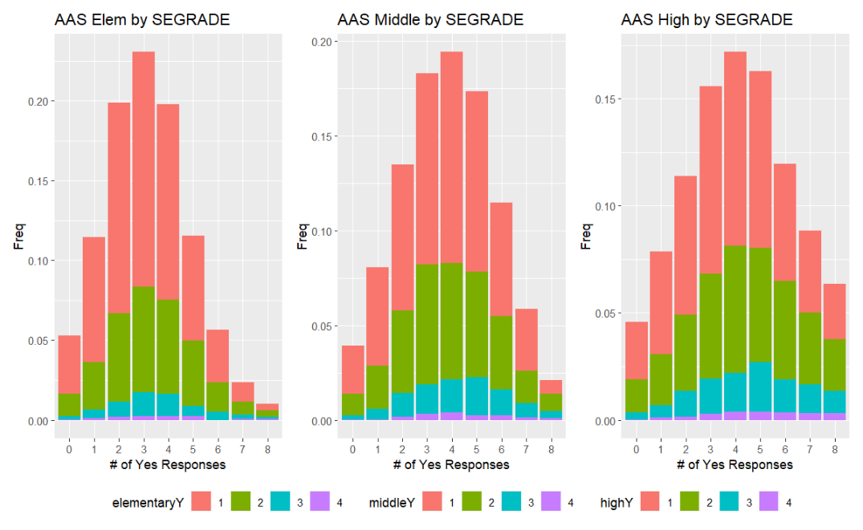

Slide 10
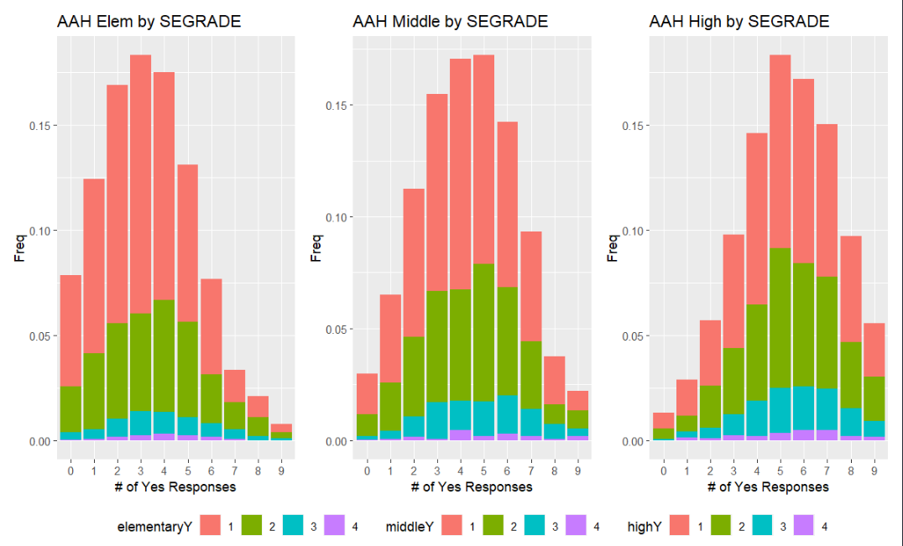

Slide 11
What’s Next
Are there other potential predictors that better influence student performance?
Are there other potential response variables that would better correlate to parent involvement (student satisfaction)?
Is the Cumulative Logit Model the best model for our data?
Is summing the binary predictors incorrect?
Is data imbalance negatively impacting the model?

Slide 12
